Slide 1


CREDIT CARD DEFAULT PREDICTION
By Rabail Adwani
Instructor: Dr. Jennifer Eigo
Course: Predictive Modeling
Date: 4th December, 2022

Slide 2
Credit card is the most preferred payment method
Overview | Data Information | Preprocessing | Modelling evaluation | Sources | Appendix 1 | Appendix 2 | Appendix 3 | Appendix 4 | Appendix 5 | Appendix 6

Slide 3

Motivation
As per Federal Reserve, 83% of the people in the United States own at least 1 credit card
Credit card debt is the significant asset of many banks
It is unsecured thus, it’s important to accurately assess risk before extending credit
Otherwise, the bank would have to eat up all the loss (interest + principal)
Overview | Data Information | Preprocessing | Modelling evaluation | Sources | Appendix 1 | Appendix 2 | Appendix 3 | Appendix 4 | Appendix 5 | Appendix 6

Slide 4

Objective
Research question: Will the customer default on the credit card payment next month?
To create a model that accurately predicts credit card defaults for the next month helping financial institutions make appropriate lending decisions for minimum insolvency
Find potential banking customers who can settle their credit card balance on time to divert marketing campaigns towards them and take credit management measures accordingly
Overview | Data Information | Preprocessing | Modelling evaluation | Sources | Appendix 1 | Appendix 2 | Appendix 3 | Appendix 4 | Appendix 5 | Appendix 6

Slide 5
Dataset information
This dataset contains information on default payments, demographic factors, credit data, history of payment, and bill statements of credit card clients in Taiwan from April 2005 to September 2005.
There are 25 columns and 30,000 rows.
Overview | Data Information | Preprocessing | Modelling evaluation | Sources | Appendix 1 | Appendix 2 | Appendix 3 | Appendix 4 | Appendix 5 | Appendix 6

Slide 6
Variable information
Dependent variable:
Default
Independent variables:
Client ID
Credit limit
Sex
Level of education
Marital status
Age
Repayment status (April 2005 to September 2005) (1 to 6)
Bill amount in TWD (April 2005 to September 2005) (1 to 6)
Payment amount (April 2005 to September 2005) (1 to 6)
Overview | Data Information | Preprocessing | Modelling evaluation | Sources | Appendix 1 | Appendix 2 | Appendix 3 | Appendix 4 | Appendix 5 | Appendix 6

Slide 7
Value labels in categorical variables
SEX
1 = Male
EDUCATION
1 = Graduate school
2 = University
MARRIAGE
1 = Married
2 = Single
PAY_1 to PAY_6
DEFAULT
2 = Female
3 = High school
4 = Others
3 = Others
-2 = No consumption
-1 = Pay duly
0 = The use of revolving credit
1 to 9= Payment delay from 1 up to 9 months
1 = Yes
0 = No
Overview | Data Information | Preprocessing | Modelling evaluation | Sources | Appendix 1 | Appendix 2 | Appendix 3 | Appendix 4 | Appendix 5 | Appendix 6

Slide 8
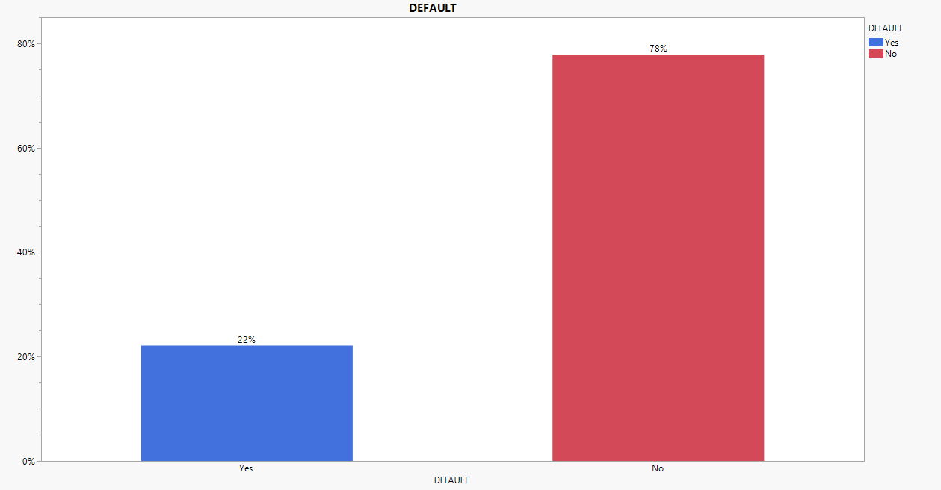
Proportion of Default levels
Overview | Data Information | Preprocessing | Modelling evaluation | Sources | Appendix 1 | Appendix 2 | Appendix 3 | Appendix 4 | Appendix 5 | Appendix 6

Slide 9
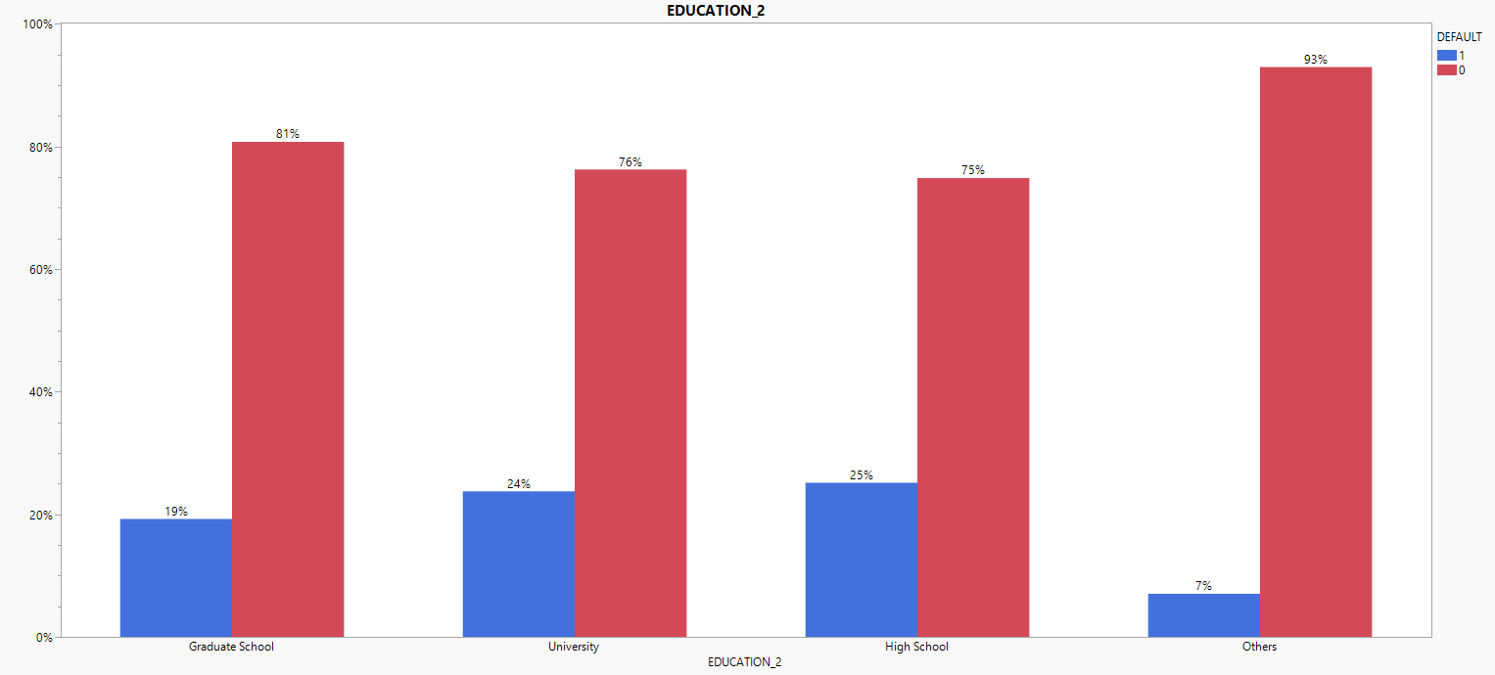
Education levels by default percentage
Overview | Data Information | Preprocessing | Modelling evaluation | Sources | Appendix 1 | Appendix 2 | Appendix 3 | Appendix 4 | Appendix 5 | Appendix 6

Slide 10
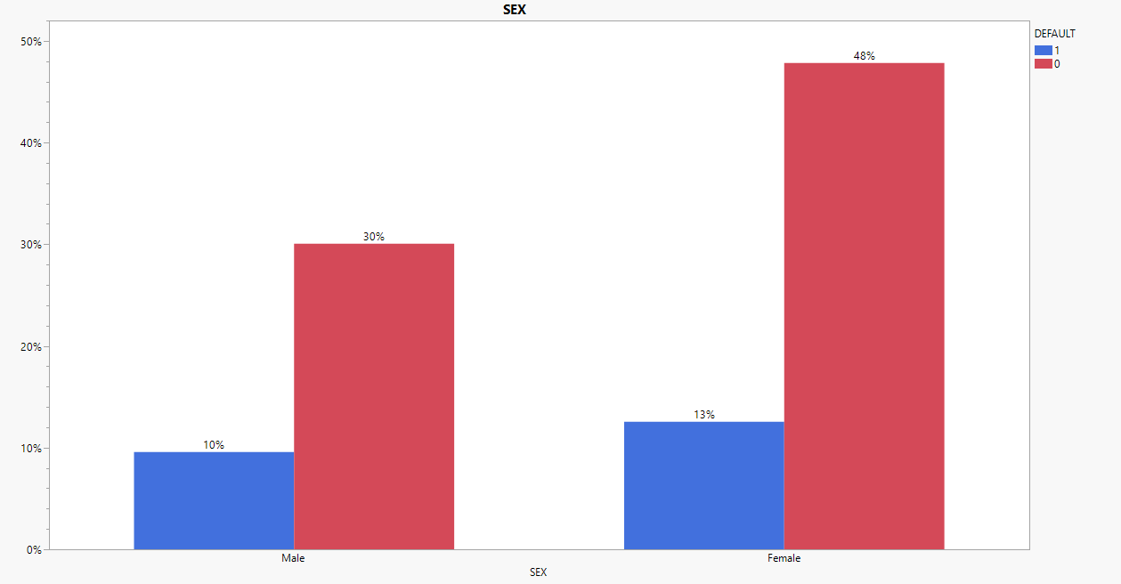
Gender by default percentage
Overview | Data Information | Preprocessing | Modelling evaluation | Sources | Appendix 1 | Appendix 2 | Appendix 3 | Appendix 4 | Appendix 5 | Appendix 6

Slide 11
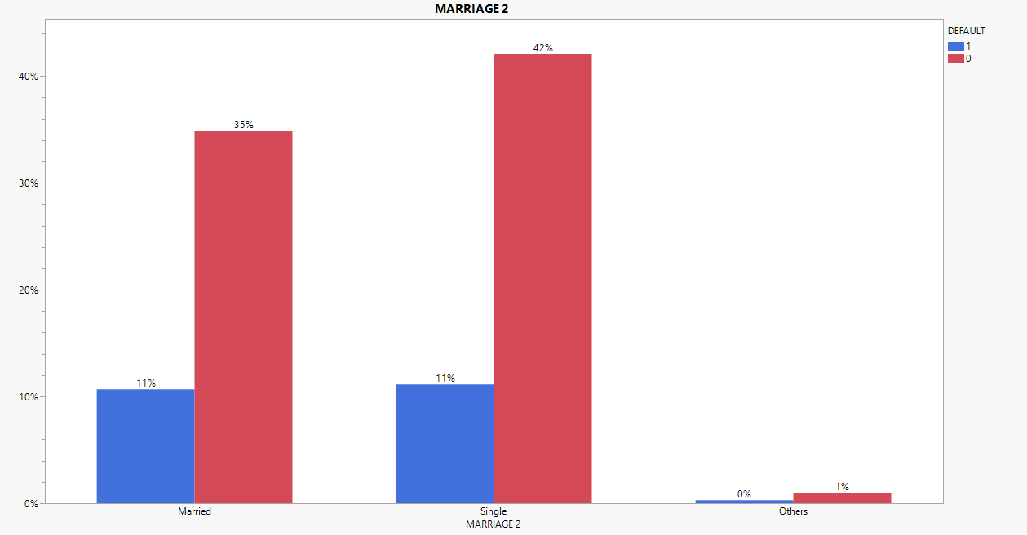
Marital status by default percentage
Overview | Data Information | Preprocessing | Modelling evaluation | Sources | Appendix 1 | Appendix 2 | Appendix 3 | Appendix 4 | Appendix 5 | Appendix 6

Slide 12
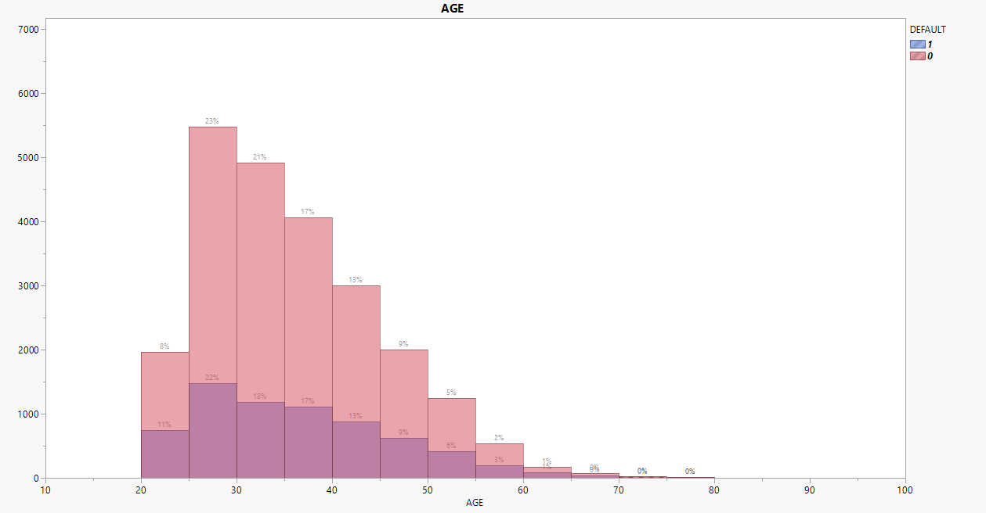
Age by default percentage
Overview | Data Information | Preprocessing | Modelling evaluation | Sources | Appendix 1 | Appendix 2 | Appendix 3 | Appendix 4 | Appendix 5 | Appendix 6

Slide 13
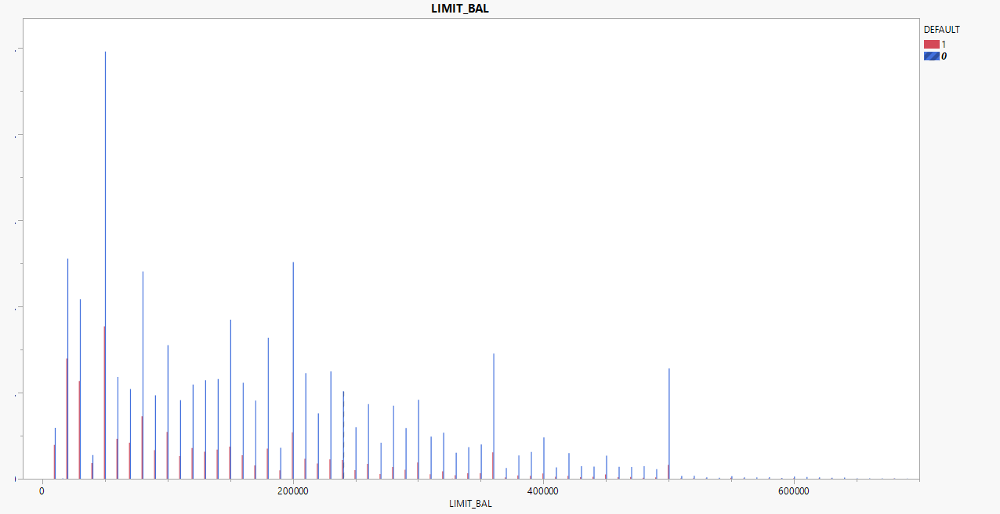
Credit card limit by default
Overview | Data Information | Preprocessing | Modelling evaluation | Sources | Appendix 1 | Appendix 2 | Appendix 3 | Appendix 4 | Appendix 5 | Appendix 6

Slide 14
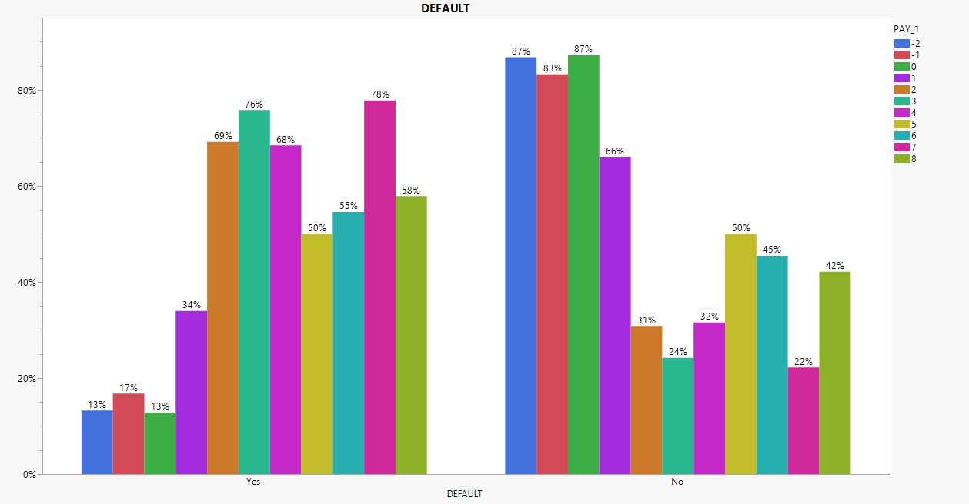
Default by repayment status 1
Overview | Data Information | Preprocessing | Modelling evaluation | Sources | Appendix 1 | Appendix 2 | Appendix 3 | Appendix 4 | Appendix 5 | Appendix 6

Slide 15
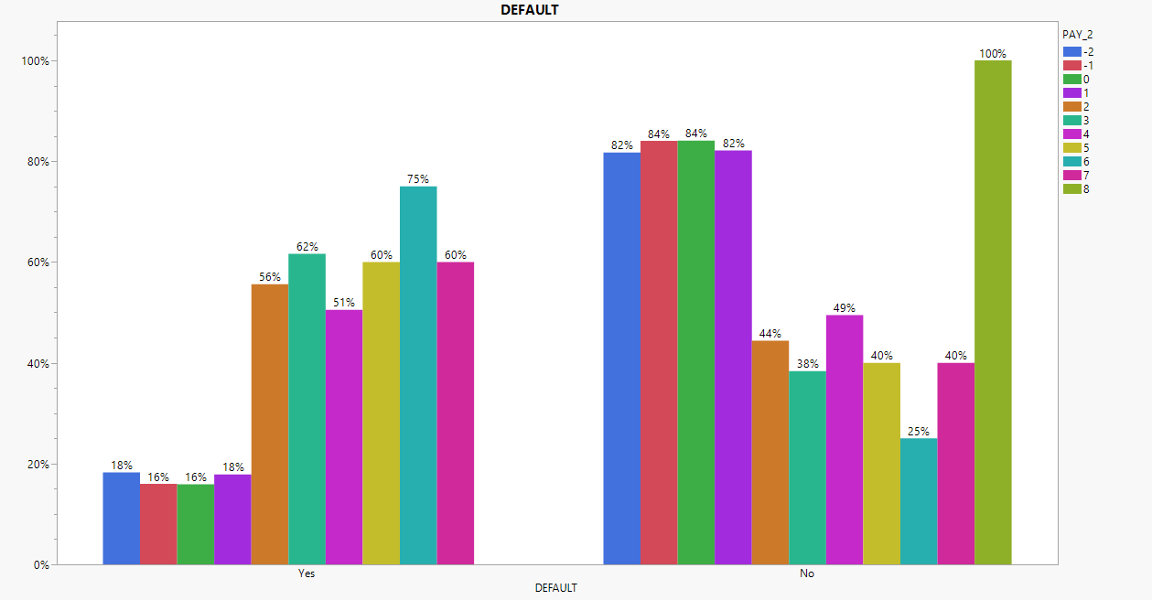
Default by repayment status 2
Overview | Data Information | Preprocessing | Modelling evaluation | Sources | Appendix 1 | Appendix 2 | Appendix 3 | Appendix 4 | Appendix 5 | Appendix 6

Slide 16
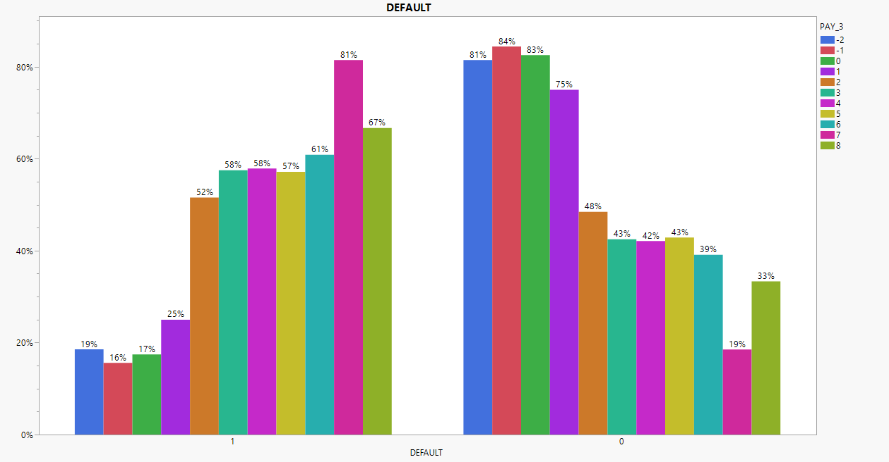
Default by repayment status 3
Overview | Data Information | Preprocessing | Modelling evaluation | Sources | Appendix 1 | Appendix 2 | Appendix 3 | Appendix 4 | Appendix 5 | Appendix 6

Slide 17
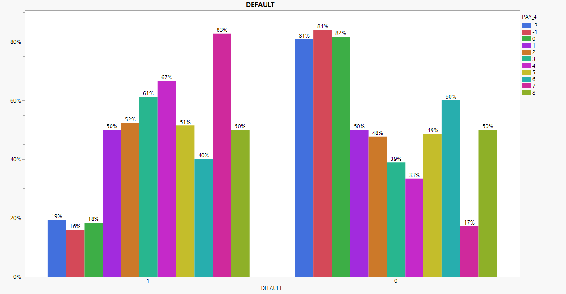
Default by repayment status 4
Overview | Data Information | Preprocessing | Modelling evaluation | Sources | Appendix 1 | Appendix 2 | Appendix 3 | Appendix 4 | Appendix 5 | Appendix 6

Slide 18
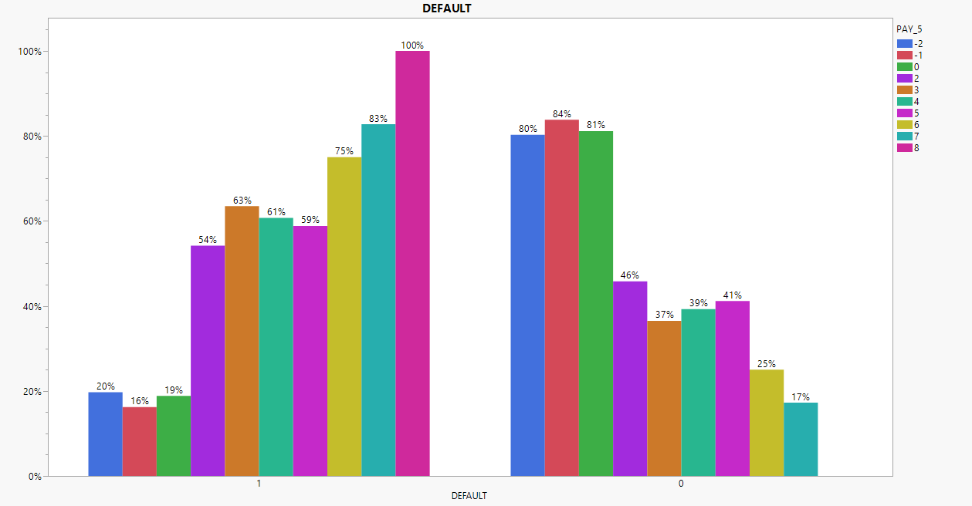
Default by repayment status 5
Overview | Data Information | Preprocessing | Modelling evaluation | Sources | Appendix 1 | Appendix 2 | Appendix 3 | Appendix 4 | Appendix 5 | Appendix 6

Slide 19
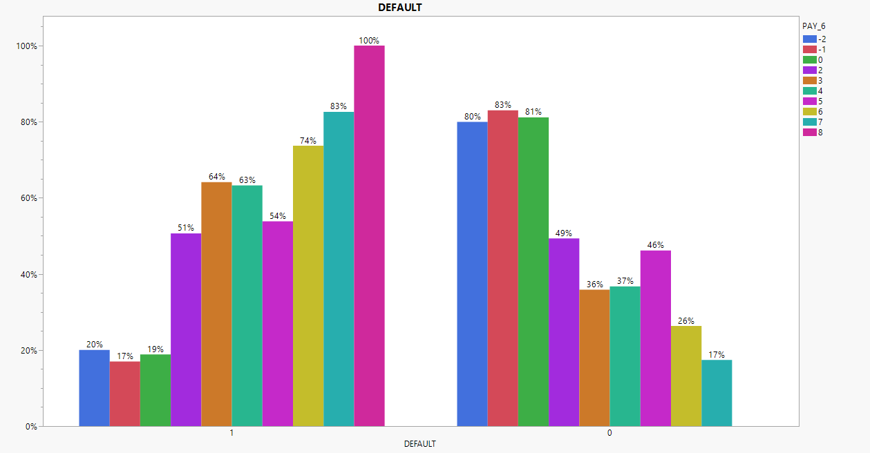
Default by repayment status 5
Overview | Data Information | Preprocessing | Modelling evaluation | Sources | Appendix 1 | Appendix 2 | Appendix 3 | Appendix 4 | Appendix 5 | Appendix 6

Slide 20
Data preprocessing
Dataset is partitioned into 60:20:20 ratio for training, validation, and testing
Changed ‘default.payment.next.month’ to ‘DEFAULT’
Changed ‘PAY_0’ to ‘PAY_1’ for ease
Excluded ‘ID’ but did not hide it
Encoded ‘SEX’, ‘EDUCATION’, ‘MARRIAGE’, ‘PAY_1’ to ‘PAY_6’, and ‘DEFAULT’ as categorical variables
Combined 0, 5, and 6 to Others in ‘EDUCATION’
Combined 0 to Others in ‘MARRIAGE’
Overview | Data Information | Preprocessing | Modelling evaluation | Sources | Appendix 1 | Appendix 2 | Appendix 3 | Appendix 4 | Appendix 5 | Appendix 6

Slide 21
Feature engineering
Variable | Formula
LIMIT_EXCEED1 | LIMIT_BAL – BILL_AMT1
LIMIT_EXCEED2 | LIMIT_BAL – BILL_AMT2
LIMIT_EXCEED3 | LIMIT_BAL – BILL_AMT3
LIMIT_EXCEED4 | LIMIT_BAL – BILL_AMT4
LIMIT_EXCEED5 | LIMIT_BAL – BILL_AMT5
LIMIT_EXCEED6 | LIMIT_BAL – BILL_AMT6
PERCENT_PAID1 | PAY_AMT1 / BILL_AMT2
PERCENT_PAID2 | PAY_AMT2 / BILL_AMT3
PERCENT_PAID3 | PAY_AMT3 / BILL_AMT4
PERCENT_PAID4 | PAY_AMT4 / BILL_AMT5
PERCENT_PAID5 | PAY_AMT5 / BILL_AMT6
Overview | Data Information | Preprocessing | Modelling evaluation | Sources | Appendix 1 | Appendix 2 | Appendix 3 | Appendix 4 | Appendix 5 | Appendix 6

Slide 22
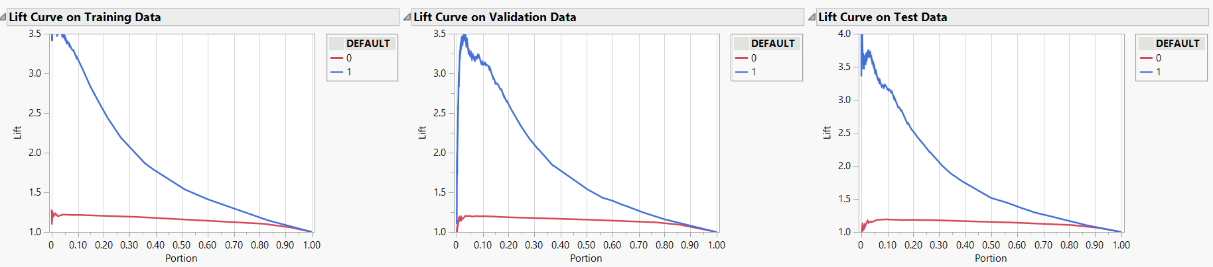
Logistic regression (All predictors)
Overview | Data Information | Preprocessing | Modelling evaluation | Sources | Appendix 1 | Appendix 2 | Appendix 3 | Appendix 4 | Appendix 5 | Appendix 6

Slide 23
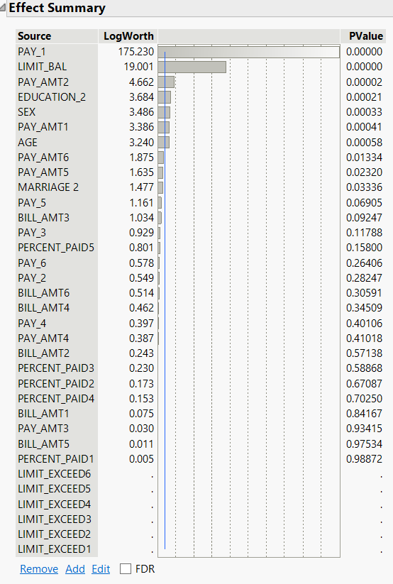
Continued..
Detailed output for Logistic regression (All predictors) is in Appendix 1
Overview | Data Information | Preprocessing | Modelling evaluation | Sources | Appendix 1 | Appendix 2 | Appendix 3 | Appendix 4 | Appendix 5 | Appendix 6

Slide 24
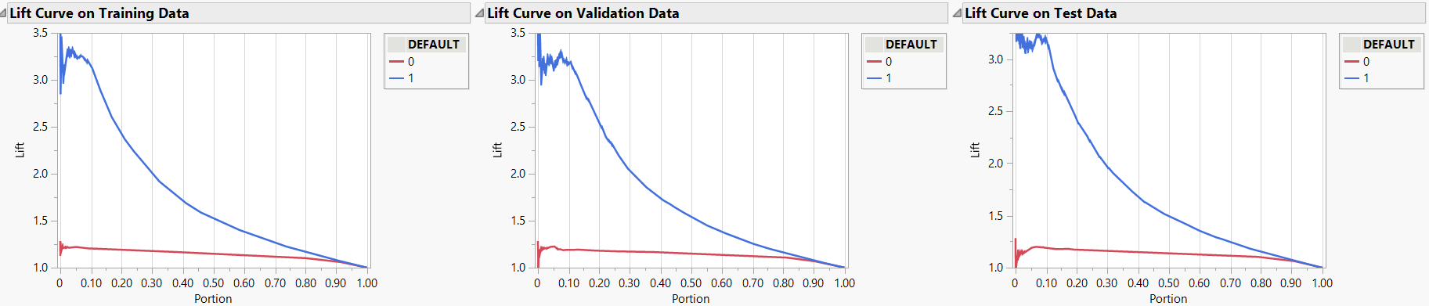
Logistic regression (Features selected based on p-value = 0.05)
Overview | Data Information | Preprocessing | Modelling evaluation | Sources | Appendix 1 | Appendix 2 | Appendix 3 | Appendix 4 | Appendix 5 | Appendix 6

Slide 25
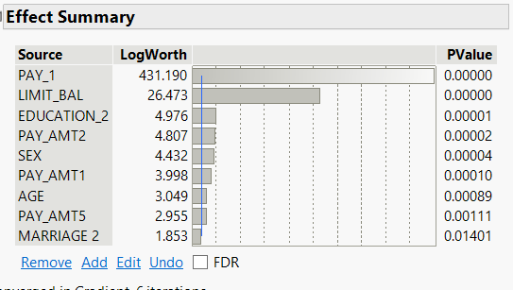
Continued..
Detailed output for Logistic regression (with feature selection) is in Appendix 2
Overview | Data Information | Preprocessing | Modelling evaluation | Sources | Appendix 1 | Appendix 2 | Appendix 3 | Appendix 4 | Appendix 5 | Appendix 6

Slide 26
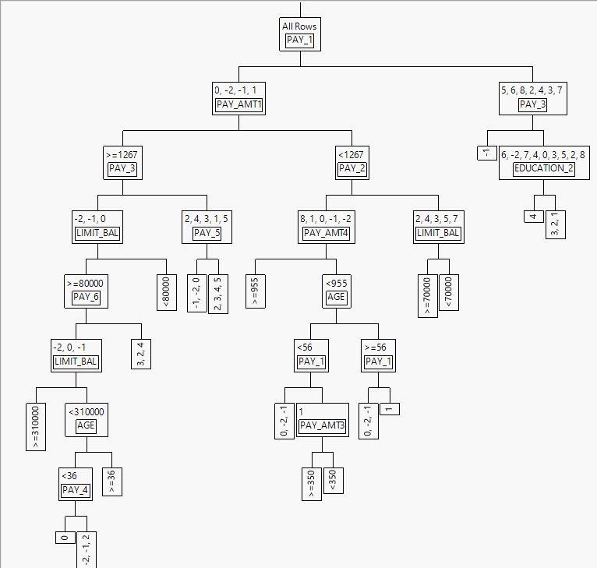
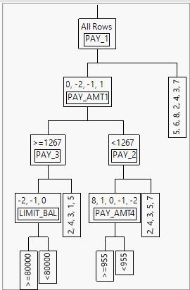
Decision tree
Overview | Data Information | Preprocessing | Modelling evaluation | Sources | Appendix 1 | Appendix 2 | Appendix 3 | Appendix 4 | Appendix 5 | Appendix 6

Slide 27
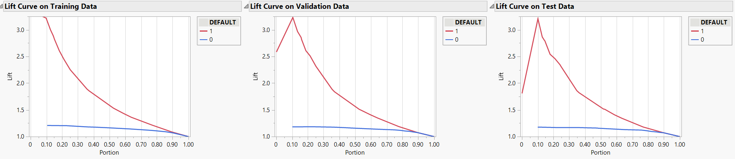
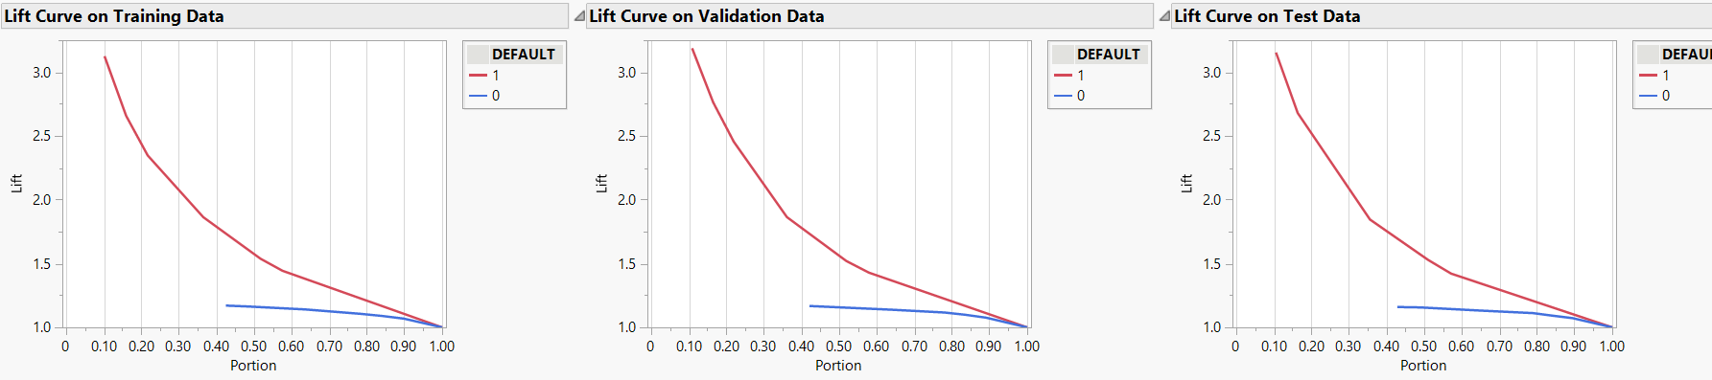
Continued..
Please refer to Appendix 3 for detailed output of decision trees
Decision tree
Pruned Decision tree
Overview | Data Information | Preprocessing | Modelling evaluation | Sources | Appendix 1 | Appendix 2 | Appendix 3 | Appendix 4 | Appendix 5 | Appendix 6

Slide 28
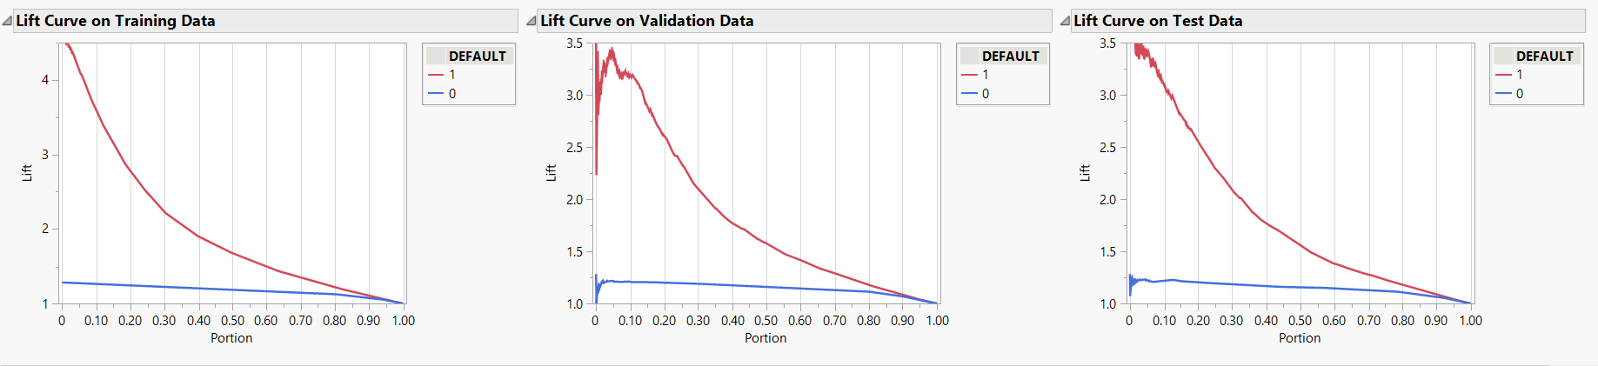
Boosted trees
Please refer to Appendix 4 for detailed output of Boosted trees
Overview | Data Information | Preprocessing | Modelling evaluation | Sources | Appendix 1 | Appendix 2 | Appendix 3 | Appendix 4 | Appendix 5 | Appendix 6

Slide 29
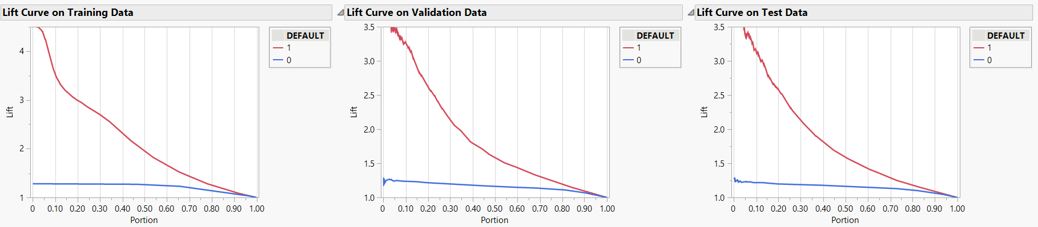
Bootstrap forest
Please refer to Appendix 5 for detailed output of Bootstrap forest
Overview | Data Information | Preprocessing | Modelling evaluation | Sources | Appendix 1 | Appendix 2 | Appendix 3 | Appendix 4 | Appendix 5 | Appendix 6

Slide 30
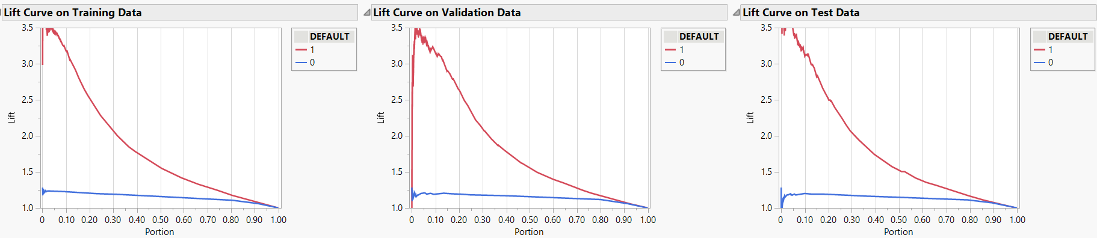
Neural network
Please refer to Appendix 6 for detailed output of Neural network
Overview | Data Information | Preprocessing | Modelling evaluation | Sources | Appendix 1 | Appendix 2 | Appendix 3 | Appendix 4 | Appendix 5 | Appendix 6

Slide 31
Test for model comparison
The Total accuracy rate is roughly the same for all the models
The precision is close to 70% for logistic regression and decision tree which is higher than others
Neural network has the highest sensitivity among others
Decision tree has the highest specificity followed by logistic regression
RASE is roughly similar for all models with very slight difference
Bootstrap forest has the highest AUC and RSquare
Overview | Data Information | Preprocessing | Modelling evaluation | Sources | Appendix 1 | Appendix 2 | Appendix 3 | Appendix 4 | Appendix 5 | Appendix 6

Slide 32
Charts for evaluation metrics of test data
Overview | Data Information | Preprocessing | Modelling evaluation | Sources | Appendix 1 | Appendix 2 | Appendix 3 | Appendix 4 | Appendix 5 | Appendix 6

Slide 33
Continued..
Overview | Data Information | Preprocessing | Modelling evaluation | Sources | Appendix 1 | Appendix 2 | Appendix 3 | Appendix 4 | Appendix 5 | Appendix 6

Slide 34
Best model
The decision tree performs well in comparison with other models.
It is easy to use as it has built variable selection mechanism
It makes no assumptions of linear relationship
It is a white-box model. If a given situation is observable in a model, the explanation for the condition is easily explained by Boolean logic
Overview | Data Information | Preprocessing | Modelling evaluation | Sources | Appendix 1 | Appendix 2 | Appendix 3 | Appendix 4 | Appendix 5 | Appendix 6

Slide 35
Recommendations
The repayment status for September (PAY_1) and August (PAY_2) have significant effect on the prediction therefore, focus on those
Establish stringent application requirements even for lower credit limit users
Conduct detailed scrutiny on the spending habits of people aged 25-30 as they can spend aggressively upon obtaining credit card
Take credit management measures based on the default prediction
Overview | Data Information | Preprocessing | Modelling evaluation | Sources | Appendix 1 | Appendix 2 | Appendix 3 | Appendix 4 | Appendix 5 | Appendix 6

Slide 36
Sources
Dataset source:
https://www.kaggle.com/datasets/uciml/default-of-credit-card-clients-dataset
Relevant paper:
Yeh, I. C., & Lien, C. H. (2009). The comparisons of data mining techniques for the predictive accuracy of probability of default of credit card clients. Expert Systems with Applications, 36(2), 2473-2480
Other sources:
https://www.statista.com/statistics/568523/preferred-payment-methods-usa/
https://upgradedpoints.com/credit-cards/credit-card-ownership-statistics/
Overview | Data Information | Preprocessing | Modelling evaluation | Sources | Appendix 1 | Appendix 2 | Appendix 3 | Appendix 4 | Appendix 5 | Appendix 6

Slide 37
Appendix Slides
Appendix 1 – Logistic regression (All predictors)
Appendix 2 – Logistic regression (with feature selection at p-value = 0.05)
Appendix 3 – Deep decision tree and pruned decision tree
Appendix 4 – Boosted trees
Appendix 5 – Bootstrap forest
Appendix 6 – Neural network

Slide 38
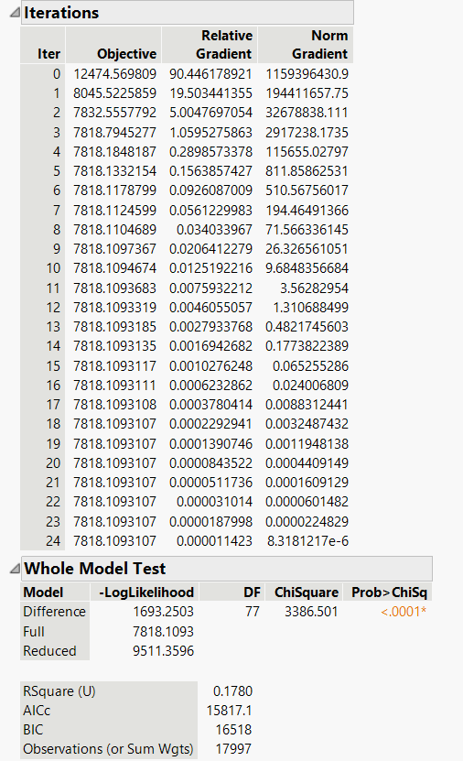
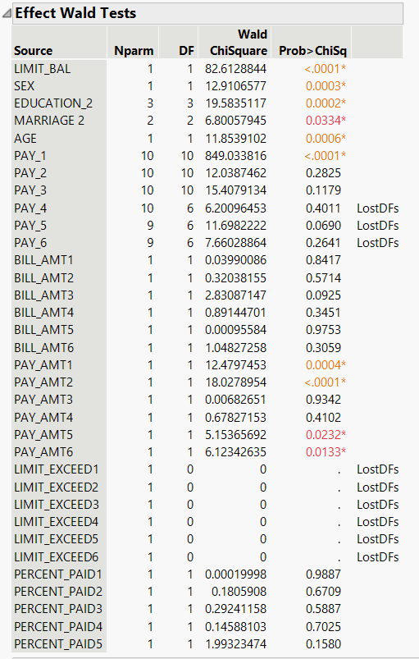
Appendix 1: Logistic regression (All predictors)
Overview | Data Information | Preprocessing | Modelling evaluation | Sources | Appendix 1 | Appendix 2 | Appendix 3 | Appendix 4 | Appendix 5 | Appendix 6

Slide 39
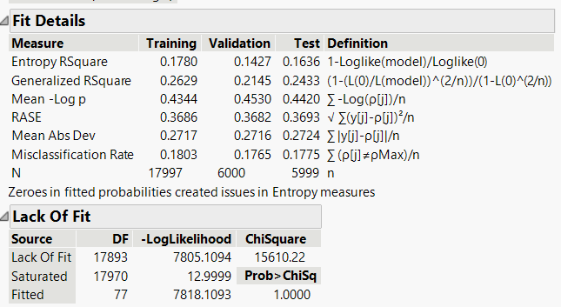
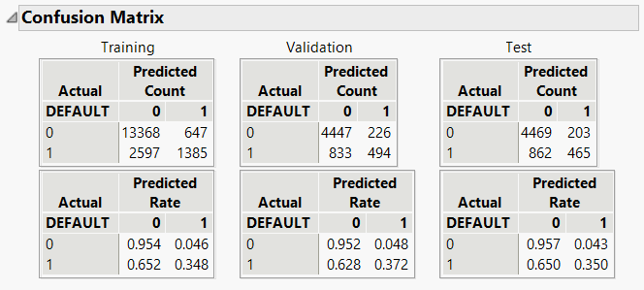
Continued..
Overview | Data Information | Preprocessing | Modelling evaluation | Sources | Appendix 1 | Appendix 2 | Appendix 3 | Appendix 4 | Appendix 5 | Appendix 6

Slide 40
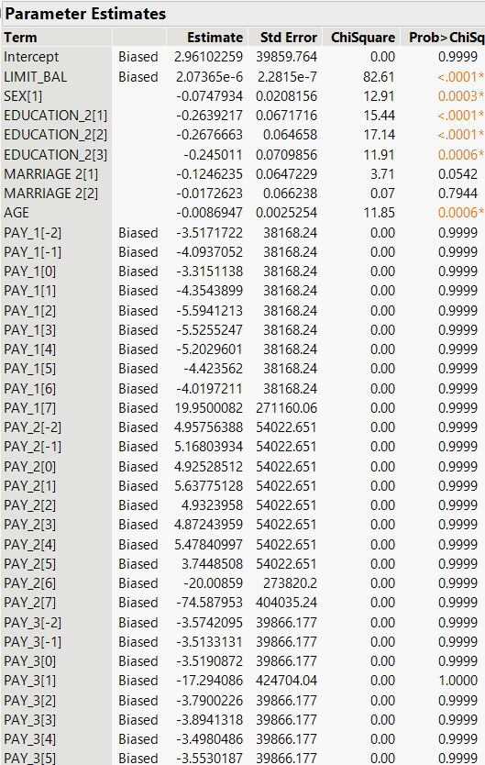
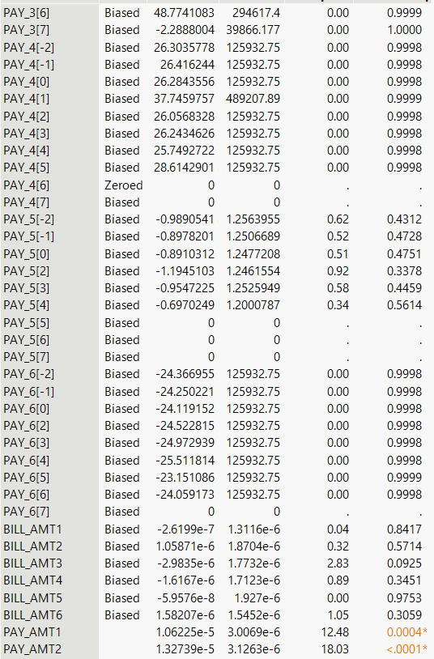
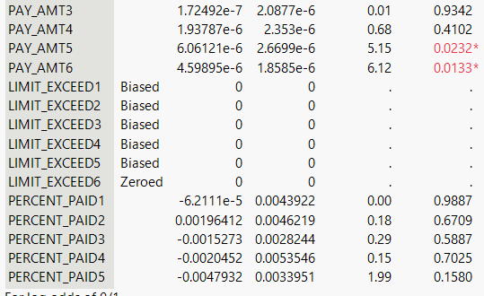
Continued..
Overview | Data Information | Preprocessing | Modelling evaluation | Sources | Appendix 1 | Appendix 2 | Appendix 3 | Appendix 4 | Appendix 5 | Appendix 6

Slide 41
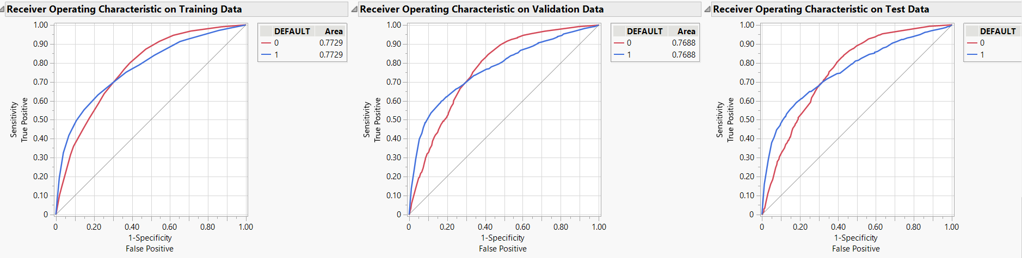
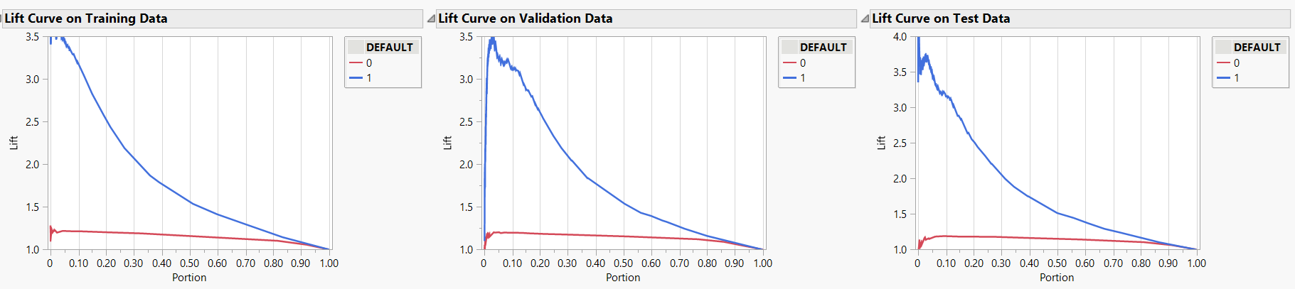
Continued..
Overview | Data Information | Preprocessing | Modelling evaluation | Sources | Appendix 1 | Appendix 2 | Appendix 3 | Appendix 4 | Appendix 5 | Appendix 6

Slide 42
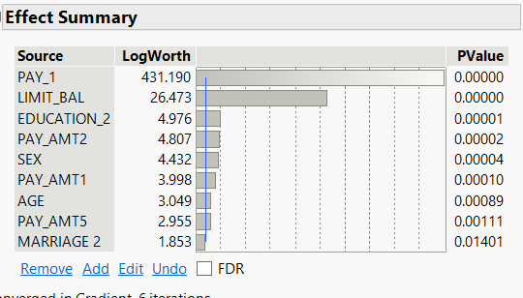
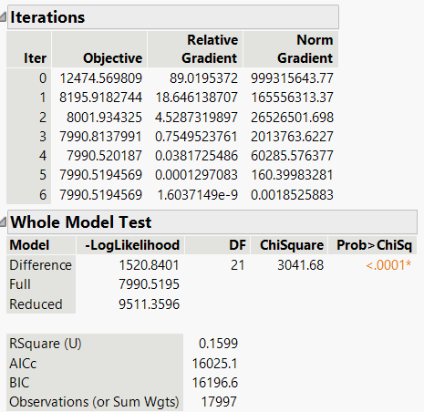
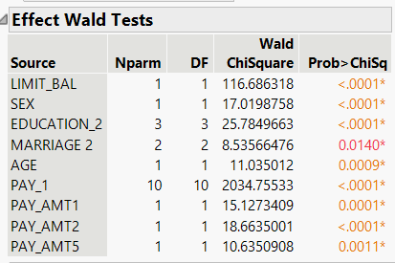
Appendix 2: Logistic regression (Features selected based on p-value = 0.05)
Overview | Data Information | Preprocessing | Modelling evaluation | Sources | Appendix 1 | Appendix 2 | Appendix 3 | Appendix 4 | Appendix 5 | Appendix 6

Slide 43
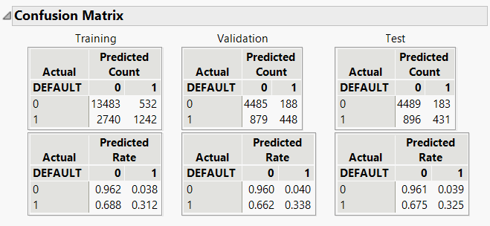
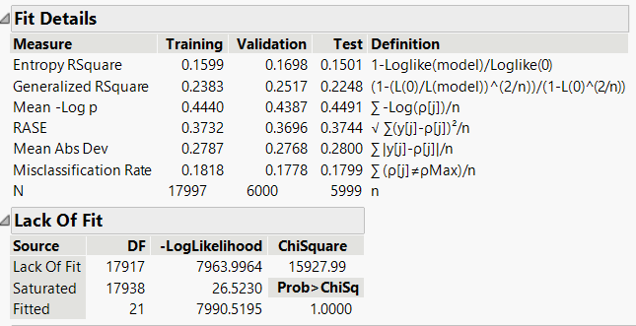
Continued..
Overview | Data Information | Preprocessing | Modelling evaluation | Sources | Appendix 1 | Appendix 2 | Appendix 3 | Appendix 4 | Appendix 5 | Appendix 6

Slide 44
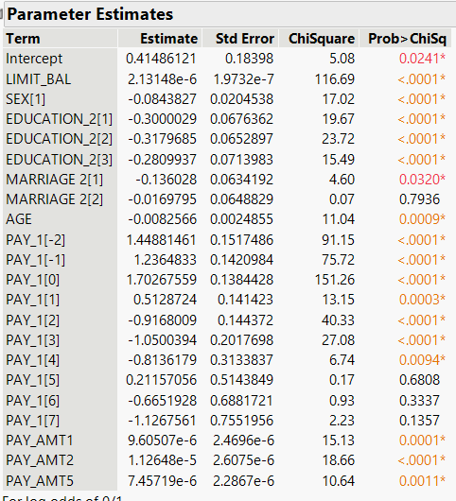
Continued..
Overview | Data Information | Preprocessing | Modelling evaluation | Sources | Appendix 1 | Appendix 2 | Appendix 3 | Appendix 4 | Appendix 5 | Appendix 6

Slide 45
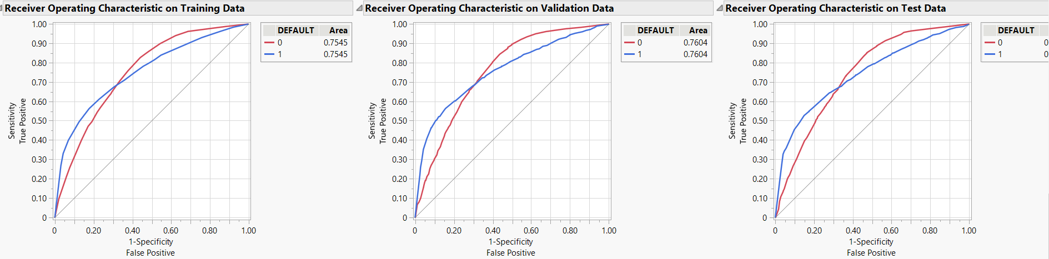
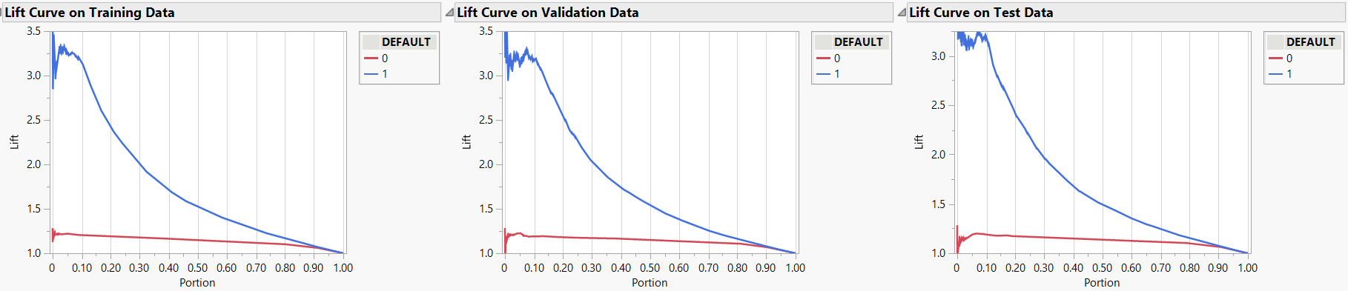
Continued..
Overview | Data Information | Preprocessing | Modelling evaluation | Sources | Appendix 1 | Appendix 2 | Appendix 3 | Appendix 4 | Appendix 5 | Appendix 6

Slide 46
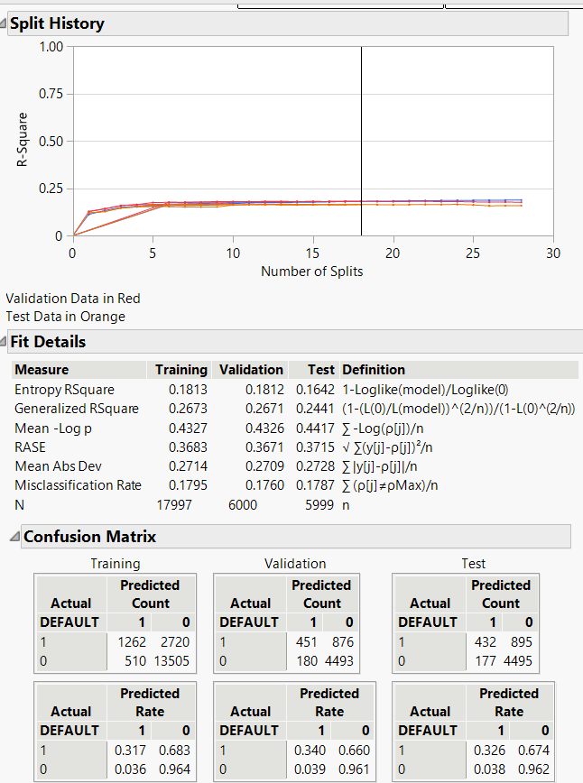
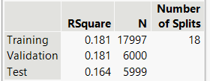
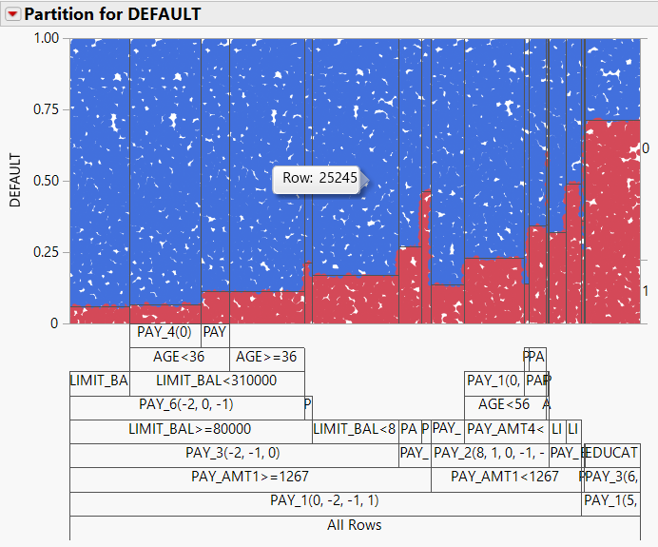
Appendix 3: Decision tree (Deep)
Overview | Data Information | Preprocessing | Modelling evaluation | Sources | Appendix 1 | Appendix 2 | Appendix 3 | Appendix 4 | Appendix 5 | Appendix 6

Slide 47
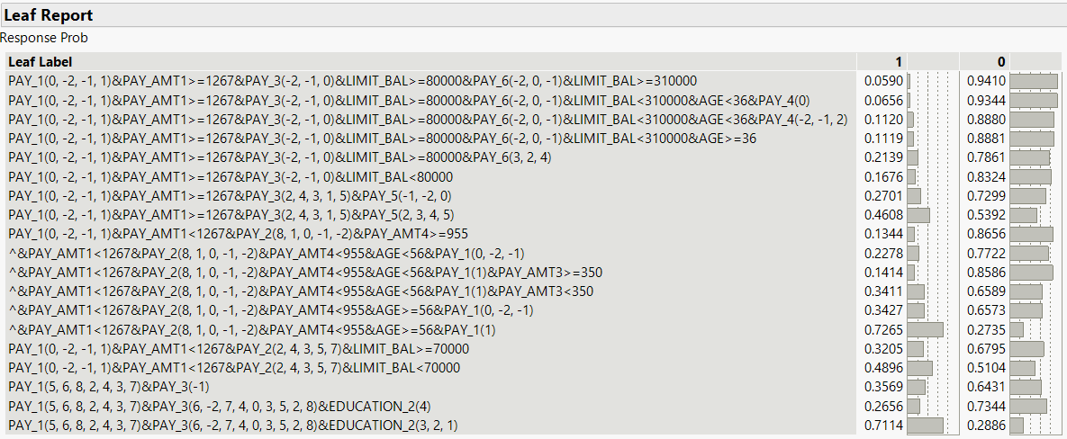
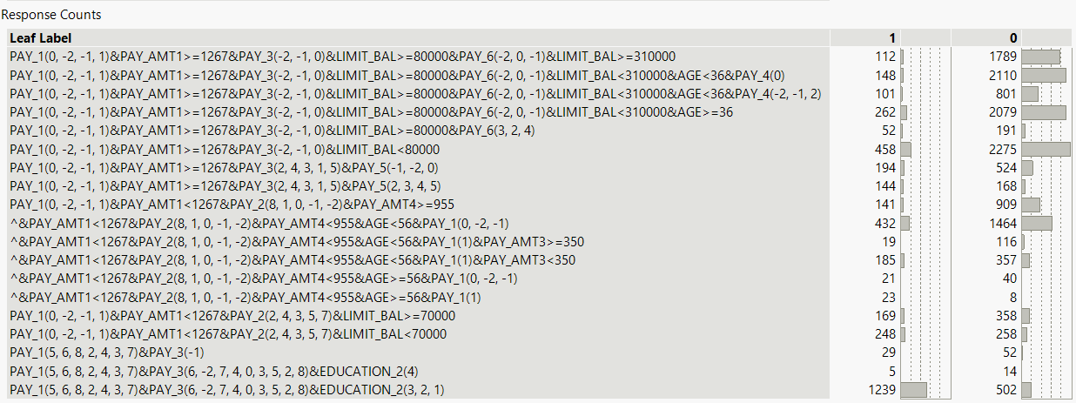
Continued..
Overview | Data Information | Preprocessing | Modelling evaluation | Sources | Appendix 1 | Appendix 2 | Appendix 3 | Appendix 4 | Appendix 5 | Appendix 6

Slide 48
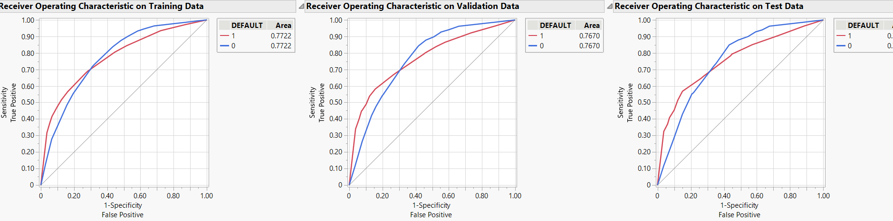
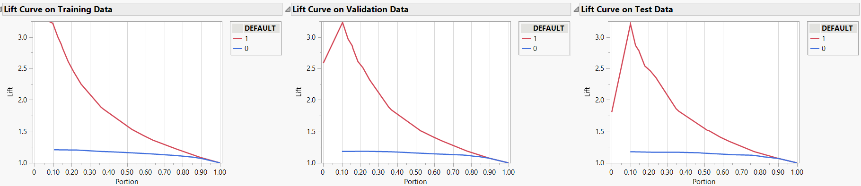
Continued..
Overview | Data Information | Preprocessing | Modelling evaluation | Sources | Appendix 1 | Appendix 2 | Appendix 3 | Appendix 4 | Appendix 5 | Appendix 6

Slide 49
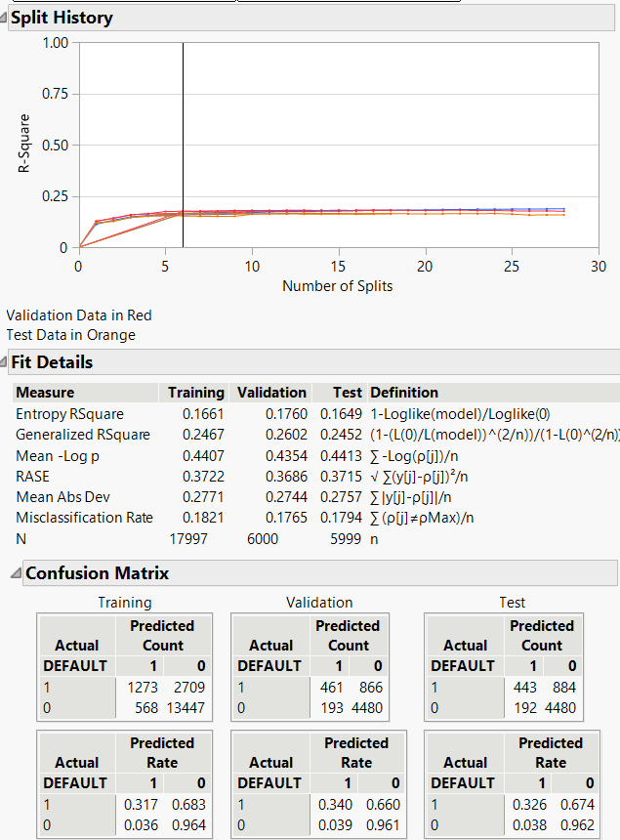
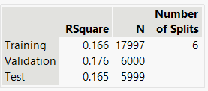
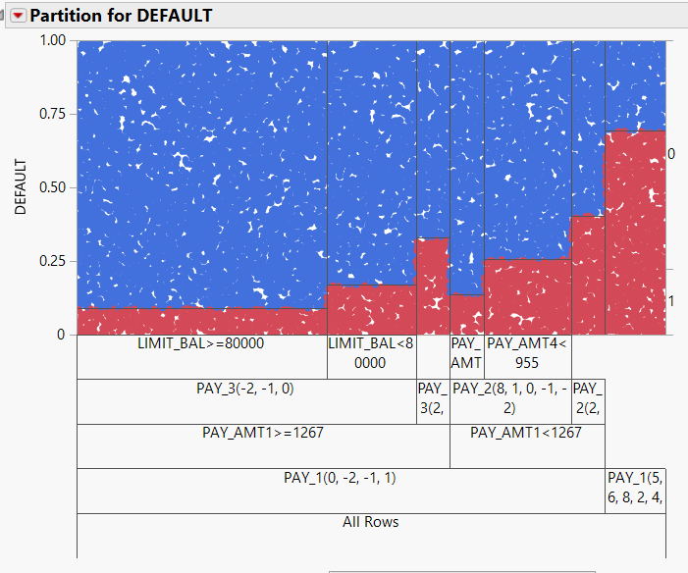
Pruned decision tree
Overview | Data Information | Preprocessing | Modelling evaluation | Sources | Appendix 1 | Appendix 2 | Appendix 3 | Appendix 4 | Appendix 5 | Appendix 6

Slide 50

Continued..
Overview | Data Information | Preprocessing | Modelling evaluation | Sources | Appendix 1 | Appendix 2 | Appendix 3 | Appendix 4 | Appendix 5 | Appendix 6

Slide 51


Continued..
Overview | Data Information | Preprocessing | Modelling evaluation | Sources | Appendix 1 | Appendix 2 | Appendix 3 | Appendix 4 | Appendix 5 | Appendix 6

Slide 52


Appendix 4: Boosted trees
Overview | Data Information | Preprocessing | Modelling evaluation | Sources | Appendix 1 | Appendix 2 | Appendix 3 | Appendix 4 | Appendix 5 | Appendix 6

Slide 53


Continued..
Overview | Data Information | Preprocessing | Modelling evaluation | Sources | Appendix 1 | Appendix 2 | Appendix 3 | Appendix 4 | Appendix 5 | Appendix 6

Slide 54


Appendix 5: Bootstrap forest
Overview | Data Information | Preprocessing | Modelling evaluation | Sources | Appendix 1 | Appendix 2 | Appendix 3 | Appendix 4 | Appendix 5 | Appendix 6

Slide 55


Continued..
Overview | Data Information | Preprocessing | Modelling evaluation | Sources | Appendix 1 | Appendix 2 | Appendix 3 | Appendix 4 | Appendix 5 | Appendix 6

Slide 56

Appendix 6: Neural network
Overview | Data Information | Preprocessing | Modelling evaluation | Sources | Appendix 1 | Appendix 2 | Appendix 3 | Appendix 4 | Appendix 5 | Appendix 6

Slide 57

Continued..
Overview | Data Information | Preprocessing | Modelling evaluation | Sources | Appendix 1 | Appendix 2 | Appendix 3 | Appendix 4 | Appendix 5 | Appendix 6

Slide 58



Continued..
Overview | Data Information | Preprocessing | Modelling evaluation | Sources | Appendix 1 | Appendix 2 | Appendix 3 | Appendix 4 | Appendix 5 | Appendix 6

Slide 59








Continued..
Overview | Data Information | Preprocessing | Modelling evaluation | Sources | Appendix 1 | Appendix 2 | Appendix 3 | Appendix 4 | Appendix 5 | Appendix 6

Slide 60


Continued..
Overview | Data Information | Preprocessing | Modelling evaluation | Sources | Appendix 1 | Appendix 2 | Appendix 3 | Appendix 4 | Appendix 5 | Appendix 6

